Slide 1
Advanced Database Modelling
Week 3
Dr. Farshid Keivanian

Slide 2
Week 3 overview
Advanced ER Modelling – Introduction
Week 3 Practice Questions with Model Answers
Week 3 Tutorial Q1 to Q3
Review and Feedback Tutorial Week 1 and 2
Submission of Tutorials & Assessments

Slide 3
Advanced ER Modelling – Introduction
Last Week (Quick Recap):
We learned how to draw basic ERDs (Entity–Relationship Diagrams).
Understood Primary Keys (PK) and Foreign Keys (FK).
Saw how entities connect using relationships (1-to-1, 1-to-many, many-to-many).

Slide 4
Advanced ER Modelling – Introduction
This Week:
We’ll level up our ERD skills → moving from simple drawings to real-world database designs.
Explore advanced ER concepts:
Generalization & Specialization (like “family tree” for entities).
Weak Entities (entities that “depend” on others).
Advanced relationships (multi-way, recursive, etc.).

Slide 5
Advanced ER Modelling – Introduction
Analogy: Think of Week 2 as LEGO basics – learning how to connect simple bricks. This week is about building a full LEGO city with roads, buildings, and rules that make it realistic.

Slide 6
Connectivity & Cardinality
Connectivity = type of relationship
1:1 (One-to-One): One passport belongs to one person.
1:M (One-to-Many): One teacher teaches many classes.
M:N (Many-to-Many): Many students join many clubs.

Slide 7
Connectivity & Cardinality
Analogy: Think of it like friendship rules:
One best friend (1:1).
One parent with many children (1:M).
Many friends who belong to many groups (M:N).

Slide 8
Connectivity & Cardinality
Cardinality = min & max number of entities in the relationship
Defines how many instances must/may exist.
Example:
A Netflix account must have at least 1 profile, but can have up to 5.
A Uni subject must have 1+ students enrolled, but there’s a cap (e.g., max 200).

Slide 9
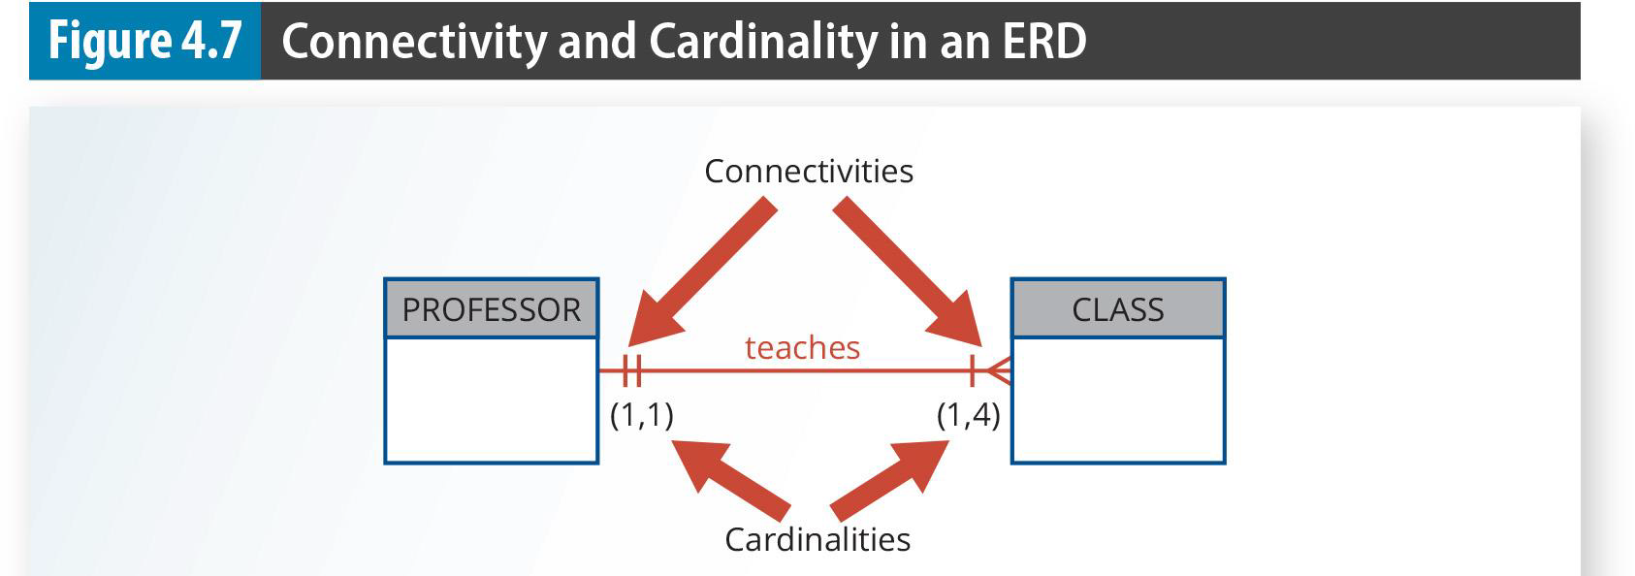
Connectivity & Cardinality
This diagram shows connectivity (type of relationship) and cardinality (how many entities can be linked). Example here: One professor must teach at least 1 class and can teach up to 4 classes (1,4), while each class must be taught by exactly 1 professor (1,1).

Slide 10
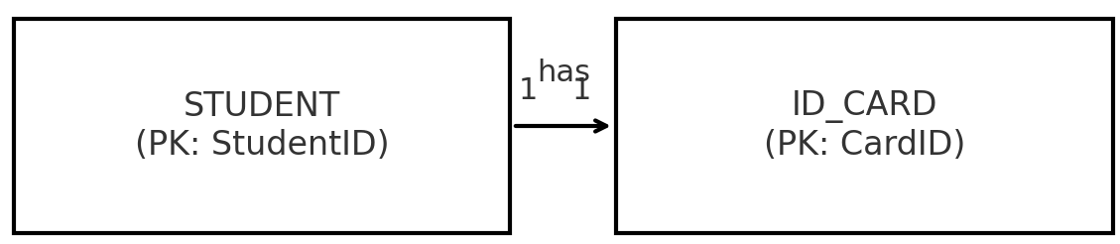
Connectivity & Cardinality
Visual Example (University)
Relationship | Connectivity | Cardinality
Student – ID Card | 1:1 | Each student must have 1 card, only 1 per student
Connectivity = relationship type (1:1, 1:M, M:N).
Cardinality = the min/max numbers (e.g., 0..M, exactly 1).

Slide 11
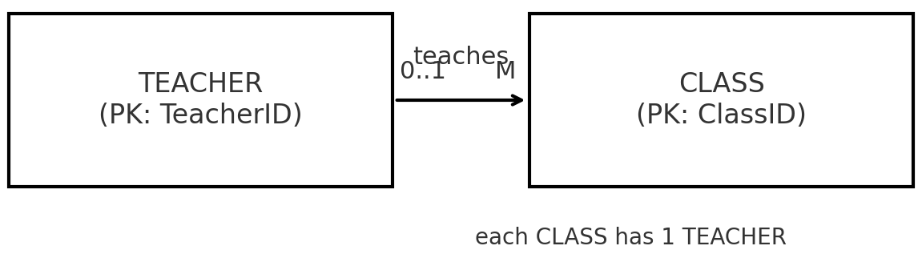
Connectivity & Cardinality
Visual Example (University)
Relationship | Connectivity | Cardinality
Teacher – Class | 1:M | A teacher can teach 0 to many classes; each class has 1 teacher

Slide 12
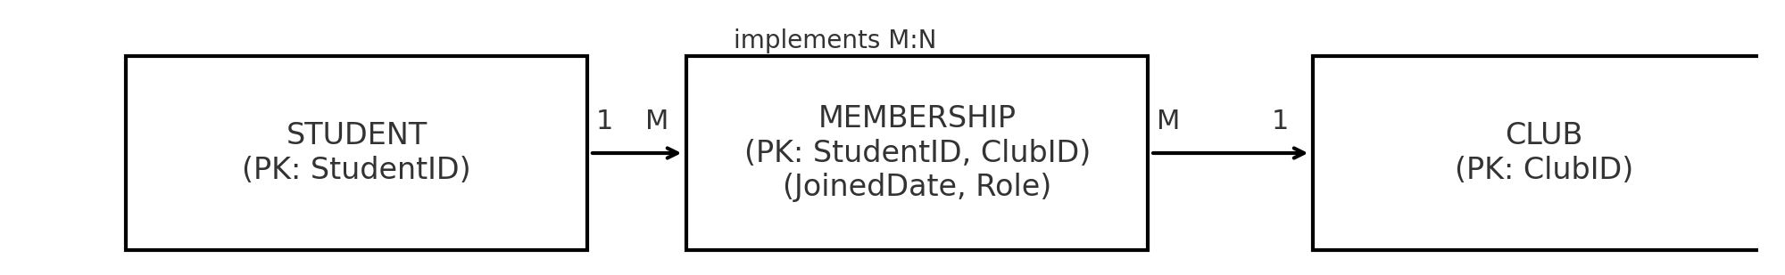
Connectivity & Cardinality
Visual Example (University)
Relationship | Connectivity | Cardinality
Student – Club | M:N | A student can join 0 to many clubs; each club has many students
For M:N, the associative entity (MEMBERSHIP) is used with a composite PK (StudentID, ClubID), so we see how M:N is implemented in a relational model.

Slide 13
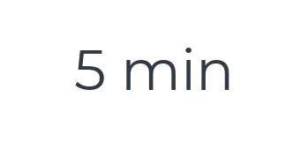
Connectivity & Cardinality
Q: Draw the relationship between Driver and Car if:
Each driver may drive many cars.
Each car must have exactly 1 driver.
Answer
Connectivity: 1:M (Driver → Car).
Cardinality: Driver (1..*) ↔ Car (1, 1).
Connectiveness
Driver
Car
drives
(1..*)
(1, 1)
Cardinalities
A driver may drive many cars, but is there a rule saying every driver must drive at least 1 car?
If yes (mandatory) → (1, M).
If no (optional) → (0, M).
may drive many cars (may = optional)

Slide 14
Existence Dependence & Weak Entities
Existence-dependent entity: Cannot exist unless another entity exists. Like a child needs a parent to exist in family records.
Weak entity: Its identity relies on another entity’s Primary Key (PK). It uses part of the parent’s PK + its own attribute.

Slide 15
Existence Dependence & Weak Entities
Analogy (Australia):
A Myki Trip Record cannot exist without a Passenger Card.
Without the passenger, there’s no trip record.

Slide 16
Existence Dependence & Weak Entities
Example Table
Entity | Existence? | Example (Australia)
Passenger Card | Exists independently | Myki Card issued to “Alice Brown”
Myki Trip Record | Needs Passenger Card (existence-dependent) | Trip on 15 Jan 2024, linked to Alice’s card

Slide 17
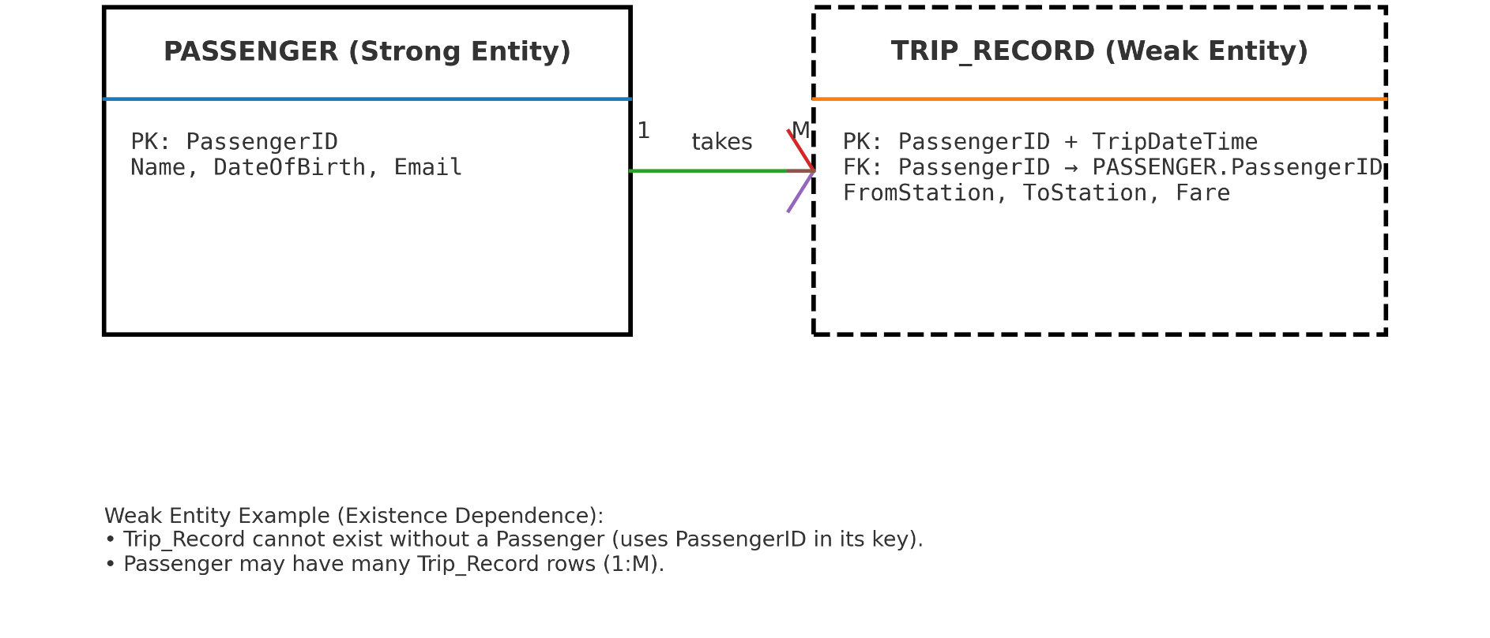
Existence Dependence & Weak Entities
Passenger (Strong Entity) has its own PK
Trip Record (Weak Entity) with a dashed box and composite key → it relies on Passenger’s PK to exist.
The “takes” relationship with 1 → M cardinality
Relationship: “Passenger takes Trip.”

Slide 18
Existence Dependence & Weak Entities
Q: Is an Order Line (line item in an invoice) existence-dependent on an Order? Why?
Yes . An order line cannot exist without an order — it’s a weak entity.

Slide 19
Relationship Strength (Strong vs Weak)
Strong vs Weak Relationship
In a strong (identifying) relationship, the child table’s primary key includes the parent’s primary key.
In a weak (non-identifying) relationship, the child table has its own independent primary key — but still uses the parent’s primary key as a foreign key for reference.

Slide 20
Relationship Strength (Strong vs Weak)
COURSE table
Each course has its own unique course code (CRS_CODE) as the primary key.
CLASS table
Each class has its own independent primary key (CLASS_CODE).

Slide 21
Relationship Strength (Strong vs Weak)
But it also keeps a CRS_CODE as a foreign key to show which course it belongs to.
This means CLASS exists on its own (with its own ID), but still depends on COURSE to know which course it’s teaching.

Slide 22
Relationship Strength (Strong vs Weak)
Real-World Analogy Think of it like:
A Course = “Bachelor of IT.”
A Class = “Monday 9 AM lecture for Bachelor of IT.”
The class has its own identity (time, room, teacher),
But it still points back to the Course it belongs to.

Slide 23
Relationship Strength (Strong vs Weak)
A strong (identifying) relationship happens when the child table uses part of the parent’s primary key as its own.

Slide 24
Relationship Strength (Strong vs Weak)
In this example:
COURSE has CRS_CODE as its PK.
CLASS uses CRS_CODE and CLASS_SECTION together as its PK.
That means a CLASS cannot exist without a COURSE, and the COURSE’s key is literally part of the CLASS’s key.

Slide 25
Relationship Strength (Strong vs Weak)
Real-world analogy: Think of a COURSE as “Accounting I” and CLASS as “Accounting I – Section 1, Monday 8am.” The class ID only makes sense if you know which course it belongs to.

Slide 26
Participation (Optional vs Mandatory)
Optional Participation: An entity can exist without being linked in a relationship.
Example: A student may exist in the database even if they haven’t enrolled in summer school yet.
Mandatory Participation: An entity must be linked in a relationship.
Example: A student must enroll in at least one subject every semester.

Slide 27
Participation (Optional vs Mandatory)
Real-World Analogy: Think of joining a gym:
Optional: You can be a member without signing up for any classes.
Mandatory: If you buy a “10-class pass,” you must use it for at least 1 class.

Slide 28
Participation (Optional vs Mandatory)
Example Table
Entity | Relationship | Optional / Mandatory | Example
Student | Summer School Enrollment | Optional | Student may choose not to join summer school.
Student | Semester Enrollment | Mandatory | Every student must take at least one subject per semester.
Course | Class | Mandatory | Each course must generate at least one class.

Slide 29
Participation (Optional vs Mandatory)
Mandatory participation in a relationship:
A course must always generate at least one class (you cannot have a course without a class).
Each class must be linked to a course, and a course must have one or more classes.
The “(1,1)” under Course means each course is linked to at least 1 class.
The “(1,N)” under Class means a course can generate many classes.

Slide 30
Participation (Optional vs Mandatory)
In real life: Think of a driving school. Each driving course must have at least one class session. You cannot advertise a “course” if no classes are scheduled.

Slide 31
Participation (Optional vs Mandatory)
Q: In a hospital, is the relationship Patient ↔ Appointment optional or mandatory?
For Patient: optional (they may not have booked yet).
For Appointment: mandatory (must belong to a patient).

Slide 32
Special Relationships
Unary (recursive): entity relates to itself.
Example: Employee manages another employee.

Slide 33
Special Relationships
Associative entity: breaks M:N into 2×1:M.
Q: A Student can enroll in many Courses, and each Course has many Students. How would you model this?
Students ↔ Courses → Enrollment table.
Create Enrollment table with (StudentID, CourseID, DateEnrolled).

Slide 34
Database Design Considerations
Good PKs: stable, numeric, not “intelligent.”
Example: Use 12345, not “IT2024-MEL.”
Q: Why is “CarPlateNumber” a bad PK? Suggest a better one.
Bad: Car plates can change → not stable.
Better: Auto-generated CarID.

Slide 35

Step-by-Step Guidance for Tutorial Week 3
Q: Draw relationships between Manufacturer → Brand → Model. Each manufacturer has many brands; each brand has many models.
Hierarchy Manufacturer → Brand → Model with 1:M → 1:M relationships
One Manufacturer can produce many Brands.
One Brand can have many Models.

Slide 36
Step-by-Step Guidance for Tutorial Week 3
Problem 1 (Hot Water Company – Spas)
Entities: Manufacturer, Brand, Model.
Relationships:
Manufacturer (1) → (M) Brand
Brand (1) → (M) Model

Slide 37
Step-by-Step Guidance for Tutorial Week 3
Attributes:
Manufacturer (code, name, address, phone).
Brand (name, level).
Model (model_no, jets, motors, price, capacity).
Guideline: Always start by highlighting nouns (entities) and verbs (relationships).

Slide 38
Step-by-Step Guidance for Tutorial Week 3
Disaster Relief Q: Volunteers can work on many Tasks, and each Task can have many Volunteers. What do we need to resolve this?
Answer: Add Assignment entity (VolunteerID, TaskID, StartTime, EndTime).

Slide 39
Step-by-Step Guidance for Tutorial Week 3
Problem 2 (United Helpers – Disaster Relief)
Entities: Volunteer, Task, Assignment, PackingList, Package, Item.
Key Relationships:
Volunteer (M) ↔ (M) Task via Assignment (with Start/EndTime).
PackingList (1) ↔ (M) Task.
Task (1) ↔ (M) Package.

Slide 40
Step-by-Step Guidance for Tutorial Week 3
Package (M) ↔ (M) Item (with quantity).
Guideline: Watch out for M:N → always break with associative entity.

Slide 41
Step-by-Step Guidance for Tutorial Week 3
Clinic Q: A Patient books an Appointment with a Doctor. Can an Appointment exist without a Patient? Without a Doctor?
No X. Each Appointment must link to exactly one Patient and one Doctor.

Slide 42
Step-by-Step Guidance for Tutorial Week 3
Problem 3 (Medical Clinic)
Entities: Patient, Doctor, Appointment, Visit, Bill, Payment, Insurance.
Relationships:
Patient (M) ↔ (M) Doctor via Appointment.
Appointment (1) → (1) Visit (diagnosis, treatment).
Visit (1) → (1) Bill.
Bill (M) ↔ (M) Payment.

Slide 43
Step-by-Step Guidance for Tutorial Week 3
Bill (1) → (0..1) Insurance Claim.
Guideline: Use real-world sense-check: Can this exist without that?

Slide 44
Step-by-Step Guidance for Tutorial Week 3
Do’s & Don’ts for Students
Do:
Extract entities from nouns and relationships from verbs in the scenario.
Check PKs unique & not null.
Break M:N into associative entities.
Use crow’s foot notation for clarity.

Slide 45
Step-by-Step Guidance for Tutorial Week 3
X Avoid:
Assuming all relationships are 1:M without evidence.
Using intelligent PKs (e.g., codes with meaning like "SPA2025-QLD").
Forgetting optional vs mandatory relationships.

Slide 46

Review and Feedback on Tutorial Week 1 and 2
This week and next week, I will review Tutorial Week 1 and 2. This will help highlight common strengths and specific errors so you can better explore how to improve. Once the review is completed, all results and feedback will be published.

Slide 47
Submission of Tutorials & Assessments
These guidelines are designed to support your learning and help you apply necessary techniques effectively. Please do the remaining problems/tasks and follow the instructions based on Canvas. If you have any questions, feel free to ask—I’m happy to help!

Slide 48
Thank You
Have a Great Learning Day!
Feel free to reach out with any questions!
Dr. Farshid Keivanian

